Slide 1
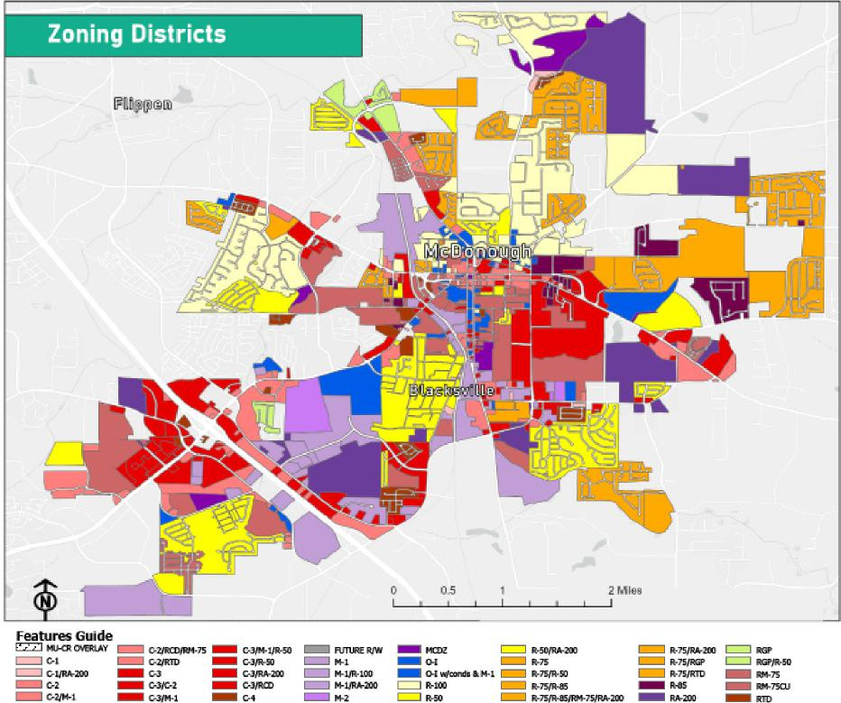
FIGURE L U - 2 ILLUSTRATES THE UPDATED ZONING MAP

