Slide 1

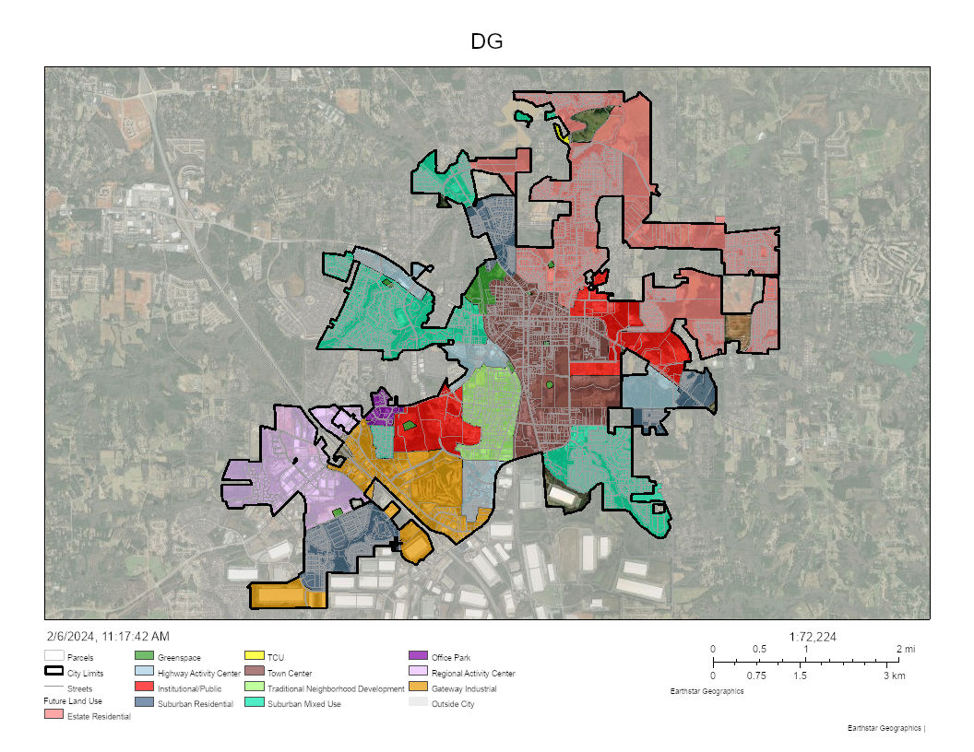

City of McDonough, GA Community Development Department Concept Compliance Staff Report For Recommendation Only
City’s FLUM Map

Slide 2
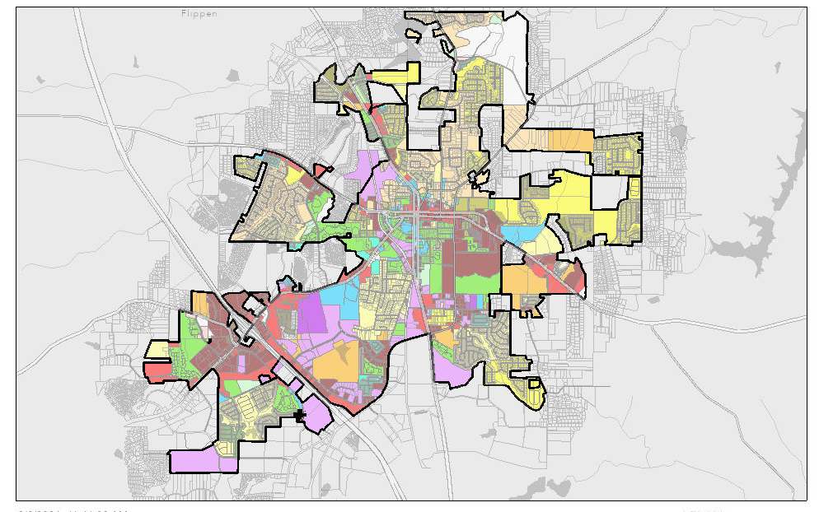

City of McDonough, GA Community Development Department Concept Compliance Staff Report For Recommendation Only
City’s Zoning Map

